Slide 1
Cosc 2150:
Computer Organization
Chapter 9, Part 3
Floating point numbers

Slide 2
Real Numbers
Two’s complement representation deal with signed integer values only.
Without modification, these formats are not useful in scientific or business applications that deal with real number values.
Floating-point representation solves this problem.

Slide 3
Floating-Point Representation
If we are clever programmers, we can perform floating-point calculations using any integer format.
This is called floating-point emulation, because floating point values aren’t stored as such; we just create programs that make it seem as if floating-point values are being used.
Most of today’s computers are equipped with specialized hardware that performs floating-point arithmetic with no special programming required.
  Not embedded processors!

Slide 4
Floating-Point Representation
Floating-point numbers allow an arbitrary number of decimal places to the right of the decimal point.
  For example: 0.5 × 0.25 = 0.125
They are often expressed in scientific notation.
  For example:
    0.125 = 1.25 × 10⁻¹
    5,000,000 = 5.0 × 10⁶

Slide 5
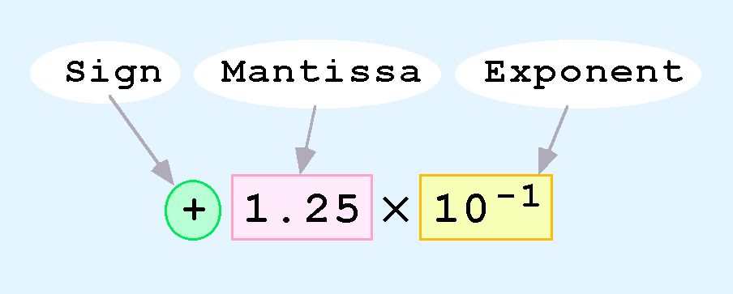
Floating-Point Representation
Computers use a form of scientific notation for floating-point representation
Numbers written in scientific notation have three components:

Slide 6
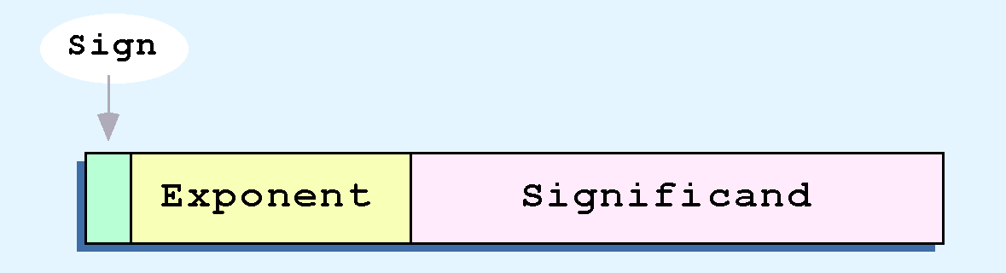
Floating-Point Representation
Computer representation of a floating-point number consists of three fixed-size fields:
This is the standard arrangement of these fields.
Note: Although “significand” and “mantissa” do not technically mean the same thing, many people use these terms interchangeably. We use the term “significand” to refer to the fractional part of a floating point number.

Slide 7
Floating-Point Representation
The one-bit sign field is the sign of the stored value.
The size of the exponent field determines the range of values that can be represented.
The size of the significand determines the precision of the representation.

Slide 8
Floating-Point Representation
We introduce a hypothetical “Simple Model” to explain the concepts
In this model:
  A floating-point number is 14 bits in length
  The exponent field is 5 bits
  The significand field is 8 bits

Slide 9
Floating-Point Representation
The significand is always preceded by an implied binary point.
Thus, the significand always contains a fractional binary value.
The exponent indicates the power of 2 by which the significand is multiplied.

Slide 10
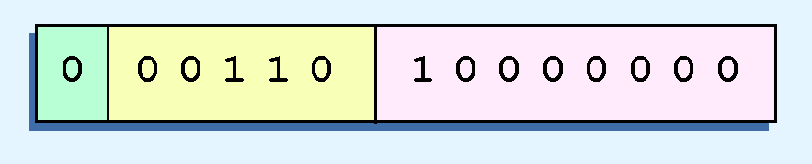
Floating-Point Representation
Example:
  Express 32₁₀ in the simplified 14-bit floating-point model.
We know that 32 is 2⁵. So in (binary) scientific notation 32 = 1.0 x 2⁵ = 0.1 x 2⁶.
  In a moment, we’ll explain why we prefer the second notation versus the first.
Using this information, we put 110 (= 6₁₀) in the exponent field and 1 in the significand as shown.

Slide 11
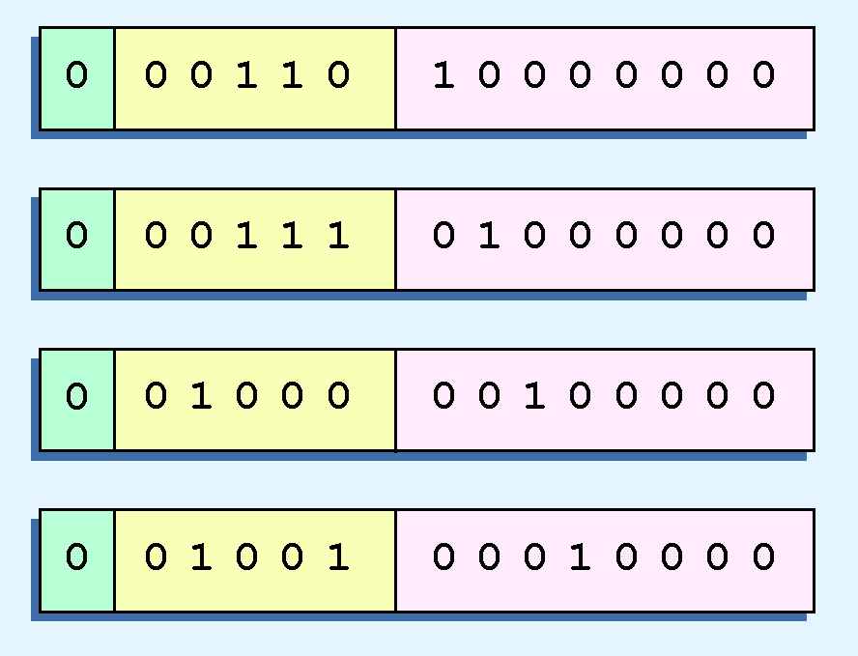
2.5 Floating-Point Representation
The illustrations shown at the right are all equivalent representations for 32 using our simplified model.
Not only do these synonymous representations waste space, but they can also cause confusion.

Slide 12
Floating-Point Representation
Another problem with our system is that we have made no allowances for negative exponents. We have no way to express 0.5 (=2 ⁻¹)! (Notice that there is no sign in the exponent field.)
All of these problems can be fixed with no changes to our basic model.

Slide 13
Floating-Point Representation
To resolve the problem of synonymous forms, we establish a rule that the first digit of the significand must be 1, with no ones to the left of the radix point.
This process, called normalization, results in a unique pattern for each floating-point number.
  In our simple model, all significands must have the form 0.1xxxxxxxx
  For example, 4.5 = 100.1 x 2⁰ = 1.001 x 2² = 0.1001 x 2³. The last expression is correctly normalized.
In our simple instructional model, we use no implied bits.

Slide 14
Floating-Point Representation
To provide for negative exponents, we will use a biased exponent.
A bias is a number that is approximately midway in the range of values expressible by the exponent. We subtract the bias from the value in the exponent to determine its true value.
  In our case, we have a 5-bit exponent. We will use 16 for our bias. This is called excess-16 representation.
In our model, exponent values less than 16 are negative, representing fractional numbers.

Slide 15
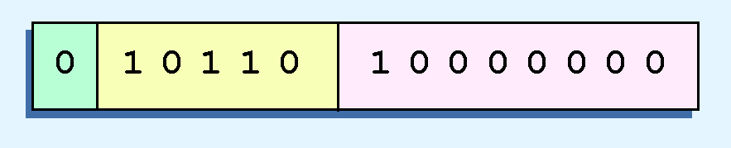
Example 1
Example:
  Express 32₁₀ in the revised 14-bit floating-point model.
We know that 32 = 1.0 x 2⁵ = 0.1 x 2⁶.
To use our excess 16 biased exponent, we add 16 to 6, giving 22₁₀ (=10110₂).
So we have:

Slide 16

Example 2
Example:
  Express 0.0625₁₀ in the revised 14-bit floating-point model.
We know that 0.0625 is 2⁻⁴. So in (binary) scientific notation 0.0625 = 1.0 x 2⁻⁴ = 0.1 x 2 ⁻³.
To use our excess 16 biased exponent, we add 16 to -3, giving 13₁₀ (=01101₂).

Slide 17

Example 3
Example:
  Express -26.625₁₀ in the revised 14-bit floating-point model.
We find 26.625₁₀ = 11010.101₂. Normalizing, we have: 26.625₁₀ = 0.11010101 x 2 ⁵.
To use our excess 16 biased exponent, we add 16 to 5, giving 21₁₀ (=10101₂). We also need a 1 in the sign bit.

Slide 18
Floating-Point Standards
The IEEE has established a standard for floating-point numbers
The IEEE-754 single precision floating point standard uses an 8-bit exponent (with a bias of 127) and a 23-bit significand.
The IEEE-754 double precision standard uses an 11-bit exponent (with a bias of 1023) and a 52-bit significand.

Slide 19
Floating-Point Representation
In both the IEEE single-precision and double-precision floating-point standard, the significant has an implied 1 to the LEFT of the radix point.
  The format for a significand using the IEEE format is: 1.xxx…
  For example, 4.5 = .1001 x 2³ in IEEE format is 4.5 = 1.001 x 2². The 1 is implied, which means is does not need to be listed in the significand (the significand would include only 001).

Slide 20
Floating-Point Representation
Example: Express -3.75 as a floating point number using IEEE single precision.
First, let’s normalize according to IEEE rules:
  3.75 = -11.11₂ = -1.111 x 2¹
  The bias is 127, so we add 127 + 1 = 128 (this is our exponent)
  The first 1 in the significand is implied, so we have:
  Since we have an implied 1 in the significand, this equates to
    -(1).111₂ x 2 ^{(128 – 127)} = -1.111₂ x 2¹ = -11.11₂ = -3.75.
(implied)

Slide 21
FP Ranges
For a 32 bit number
  8 bit exponent
  +/- 2²⁵⁶ ≈ 1.5 x 10⁷⁷
Accuracy
  The effect of changing lsb of significand
  23 bit significand 2⁻²³ ≈ 1.2 x 10⁻⁷
  About 6 decimal places

Slide 22
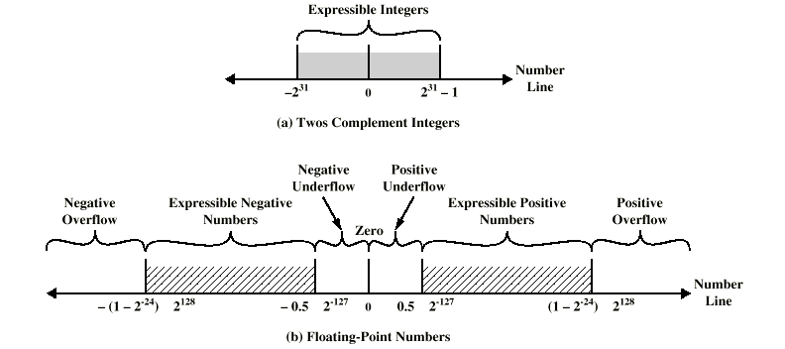
Expressible Numbers

Slide 23
Floating-Point Representation
Using the IEEE-754 single precision floating point standard:
  An exponent of 255 indicates a special value.
    If the significand is zero, the value is ± infinity.
    If the significand is nonzero, the value is NaN, “not a number,” often used to flag an error condition.
Using the double precision standard:
  The “special” exponent value for a double precision number is 2047, instead of the 255 used by the single precision standard.

Slide 24
Floating-Point Representation
Both the 14-bit model that we have presented and the IEEE-754 floating point standard allow two representations for zero.
  Zero is indicated by all zeros in the exponent and the significand, but the sign bit can be either 0 or 1.
This is why programmers should avoid testing a floating-point value for equality to zero.
  Negative zero does not equal positive zero.

Slide 25
Floating-Point Representation
Floating-point addition and subtraction are done using methods analogous to how we perform calculations using pencil and paper.
The first thing that we do is express both operands in the same exponential power, then add the numbers, preserving the exponent in the sum.
If the exponent requires adjustment, we do so at the end of the calculation.

Slide 26
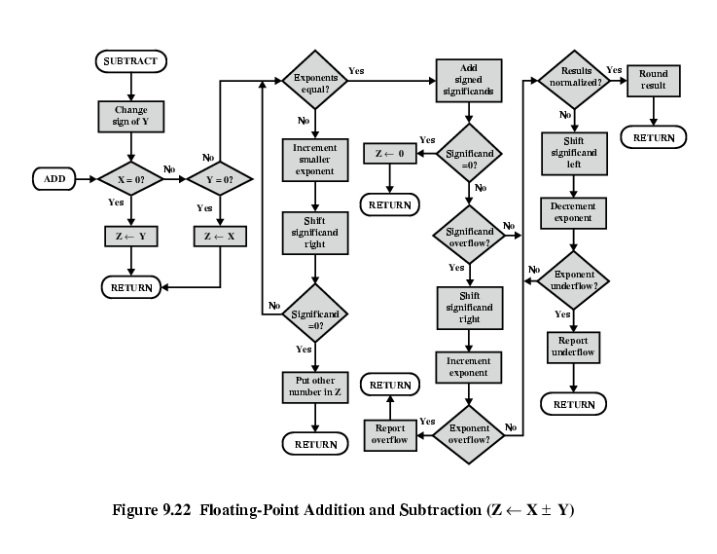
FP Addition & Subtraction Flowchart

Slide 27
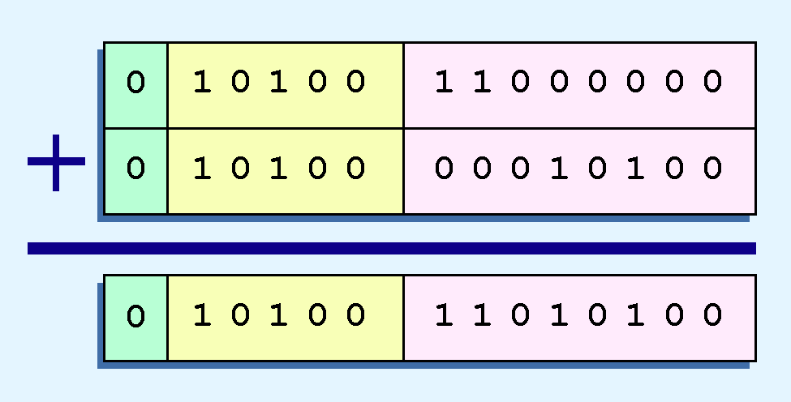
Floating-Point addition example
Example:
  Find the sum of 12₁₀ and 1.25₁₀ using the 14-bit “simple” floating-point model.
We find 12₁₀ = 0.1100 x 2 ⁴. And 1.25₁₀ = 0.101 x 2 ¹ = 0.000101 x 2 ⁴.
Thus, our sum is 0.110101 x 2 4.

Slide 28
Floating-Point Multiplication
Floating-point multiplication is also carried out in a manner akin to how we perform multiplication using pencil and paper.
We multiply the two operands and add their exponents.
If the exponent requires adjustment, we do so at the end of the calculation.

Slide 29
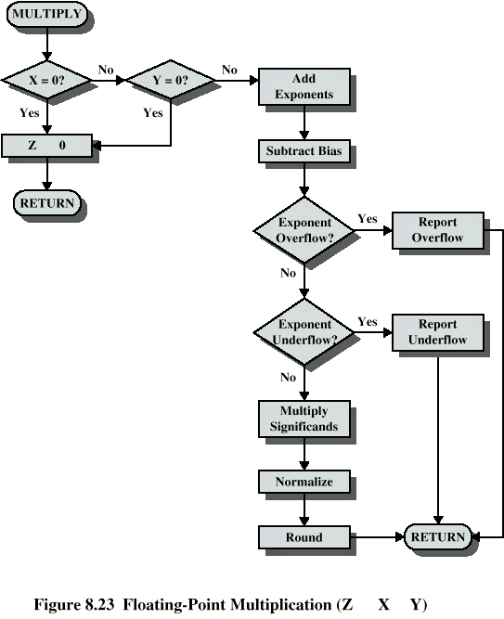
Floating Point Multiplication flowchart

Slide 30
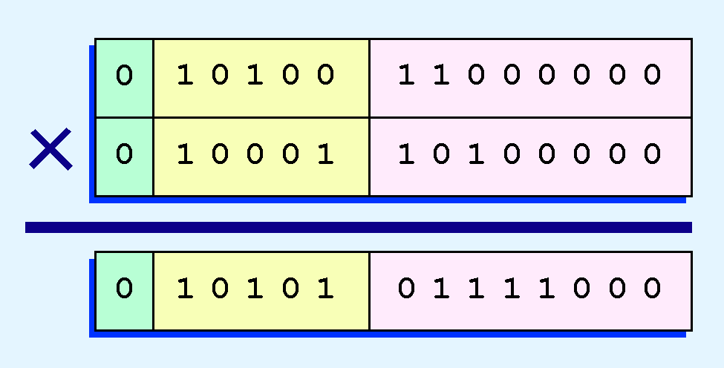
Floating-Point Multiplication Example
Example:
  Find the product of 12₁₀ and 1.25₁₀ using the 14-bit floating-point model.
We find 12₁₀ = 0.1100 x 2 ⁴. And 1.25₁₀ = 0.101 x 2 ¹.
Thus, our product is 0.0111100 x 2 5 = 0.1111 x 2 4.
The normalized product requires an exponent of 22₁₀ = 10110₂.

Slide 31
Rounding and Errors
No matter how many bits we use in a floating-point representation, our model must be finite.
The real number system is, of course, infinite, so our models can give nothing more than an approximation of a real value.
At some point, every model breaks down, introducing errors into our calculations.
By using a greater number of bits in our model, we can reduce these errors, but we can never totally eliminate them.

Slide 32
Rounding and Errors
Our job becomes one of reducing error, or at least being aware of the possible magnitude of error in our calculations.
We must also be aware that errors can compound through repetitive arithmetic operations.
For example, our 14-bit model cannot exactly represent the decimal value 128.5. In binary, it is 9 bits wide:
  10000000.1₂ = 128.5₁₀

Slide 33
2.5 Rounding and Errors
When we try to express 128.5₁₀ in our 14-bit model, we lose the low-order bit, giving a relative error of:
If we had a procedure that repetitively added 0.5 to 128.5, we would have an error of nearly 2% after only four iterations.
128.5 - 128
128.5
≈ 0.39%

Slide 34
Rounding and Errors
Floating-point errors can be reduced when we use operands that are similar in magnitude.
If we were repetitively adding 0.5 to 128.5, it would have been better to iteratively add 0.5 to itself and then add 128.5 to this sum.
In this example, the error was caused by loss of the low-order bit.
Loss of the high-order bit is more problematic.

Slide 35
Rounding and Errors
Floating-point overflow and underflow can cause programs to crash.
Overflow occurs when there is no room to store the high-order bits resulting from a calculation.
Underflow occurs when a value is too small to store, possibly resulting in division by zero.
Experienced programmers know that it’s better for a program to crash than to have it produce incorrect, but plausible, results.
EVEN BETTER, CAUGHT THE ERROR and DEAL WITH IT!

Slide 36
Rounding and Errors
When discussing floating-point numbers, it is important to understand the terms range, precision, and accuracy.
The range of a numeric integer format is the difference between the largest and smallest values that can be expressed.
Accuracy refers to how closely a numeric representation approximates a true value.
The precision of a number indicates how much information we have about a value

Slide 37
Rounding and Errors
Most of the time, greater precision leads to better accuracy, but this is not always true.
  For example, 3.1333 is a value of pi that is accurate to two digits, but has 5 digits of precision.
There are other problems with floating point numbers.
Because of truncated bits, you cannot always assume that a particular floating point operation is commutative or distributive.

Slide 38
Rounding and Errors
This means that we cannot assume:
    (a + b) + c = a + (b + c) or
    a*(b + c) = ab + ac
Moreover, to test a floating point value for equality to some other number, it is best to declare a “nearness to x” epsilon value. For example, instead of checking to see if floating point x is equal to 2 as follows:
  if x == 2 then …
  it is better to use:
    if (abs(x - 2) < epsilon) then ...
    (assuming we have epsilon defined correctly!)

Slide 39
Q
A
&

